Slide 1
Seminar in Marketing Analytics
Linear Regression
Analysis of Pilgrim Bank Case Study

Slide 2
A small bank mostly active in Texas
The story takes place around 2003
Big questions
Are online customers more profitable?
Is going online lead to higher profits?

Slide 3
The Data
A sample
20,000 customers
randomly selected
First, we handle
missing values
categorical variables
Then, analyze and answer questions

Slide 4
Alternative Methods of Handling missing data
Delete the record
If you have plenty of the data this can be best method
Replace with imputed value (such as mean median)
Reduces the correlations between variables
Replace with 0 and add a dummy variable
If missing 1 otherwise 0

Slide 5
Handling categorical variables
Use factor function in R.

Slide 6
Pilgrim Bank (A) Questions
How much variation in profitability is observed across customers and how could Pilgrim best deal with this variability?
Based on the 1999 sample of customers, what can Green conclude about the average profitability of Pilgrim Bank customers?

Slide 7
Pilgrim Bank (A) Questions
Is the difference in average profitability between online and offline customers in the sample indicative of a meaningful difference in profitability across these groups in the entire population of Pilgrim Bank’s customers?

Slide 8
Pilgrim Bank (A) Questions
What is the role of customer demographics in comparing online and offline profitability?
Can cause and effect be established between online usage and customer profitability?

Slide 9
Question 1
How much variation in profitability is observed across customers?
How could Pilgrim best deal with this variability?

Slide 10
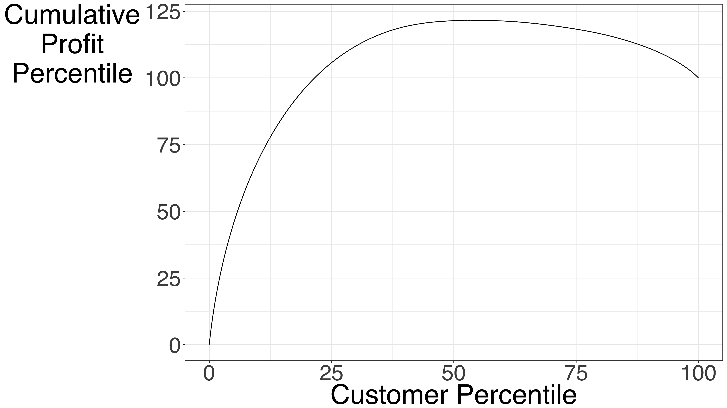

Slide 11
question 2
Based on the 1999 sample of customers, what can Green conclude about the average profitability of Pilgrim Bank customers?
1999 sample mean is $111.51
The 95% confidence interval of the population mean is ($108.50, $114.51)

Slide 12
question 3
Are online and offline customer different in term of their profitability?
For the sample, average profits for the online customers is $5.88 more then the offline customers

Slide 13
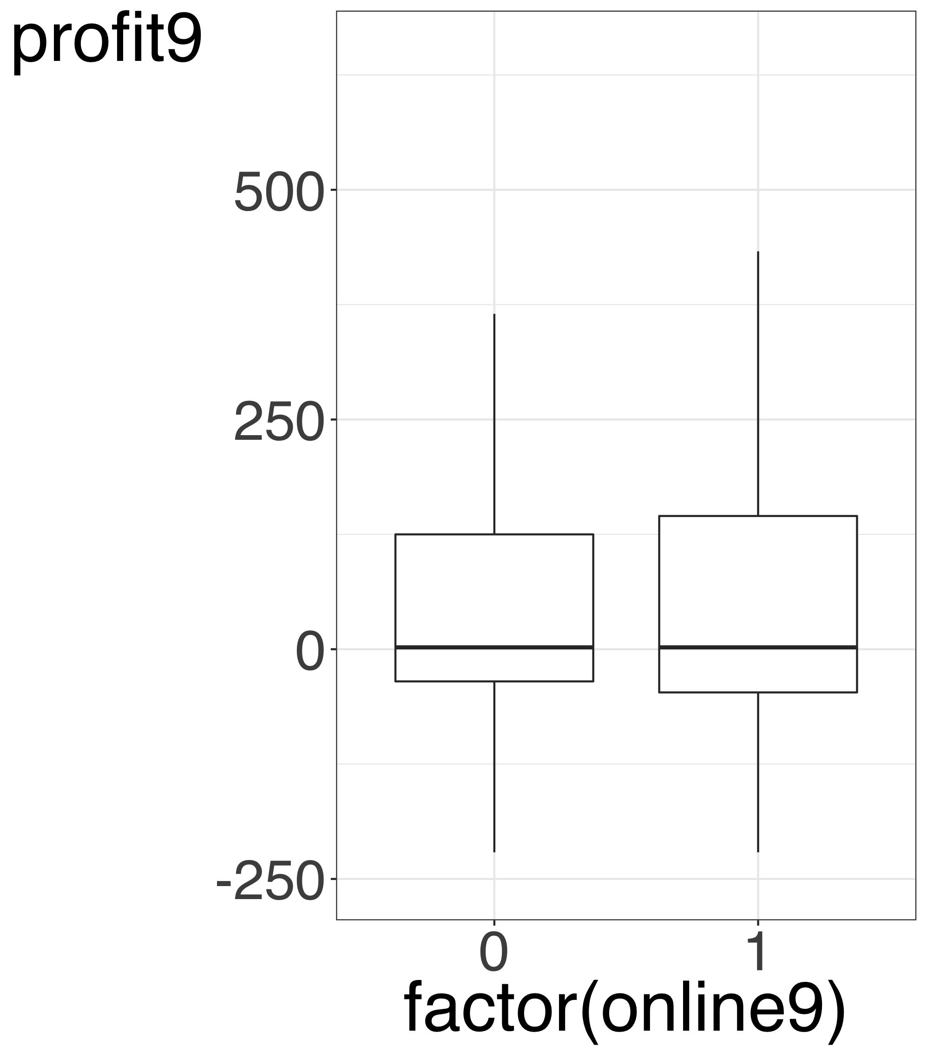
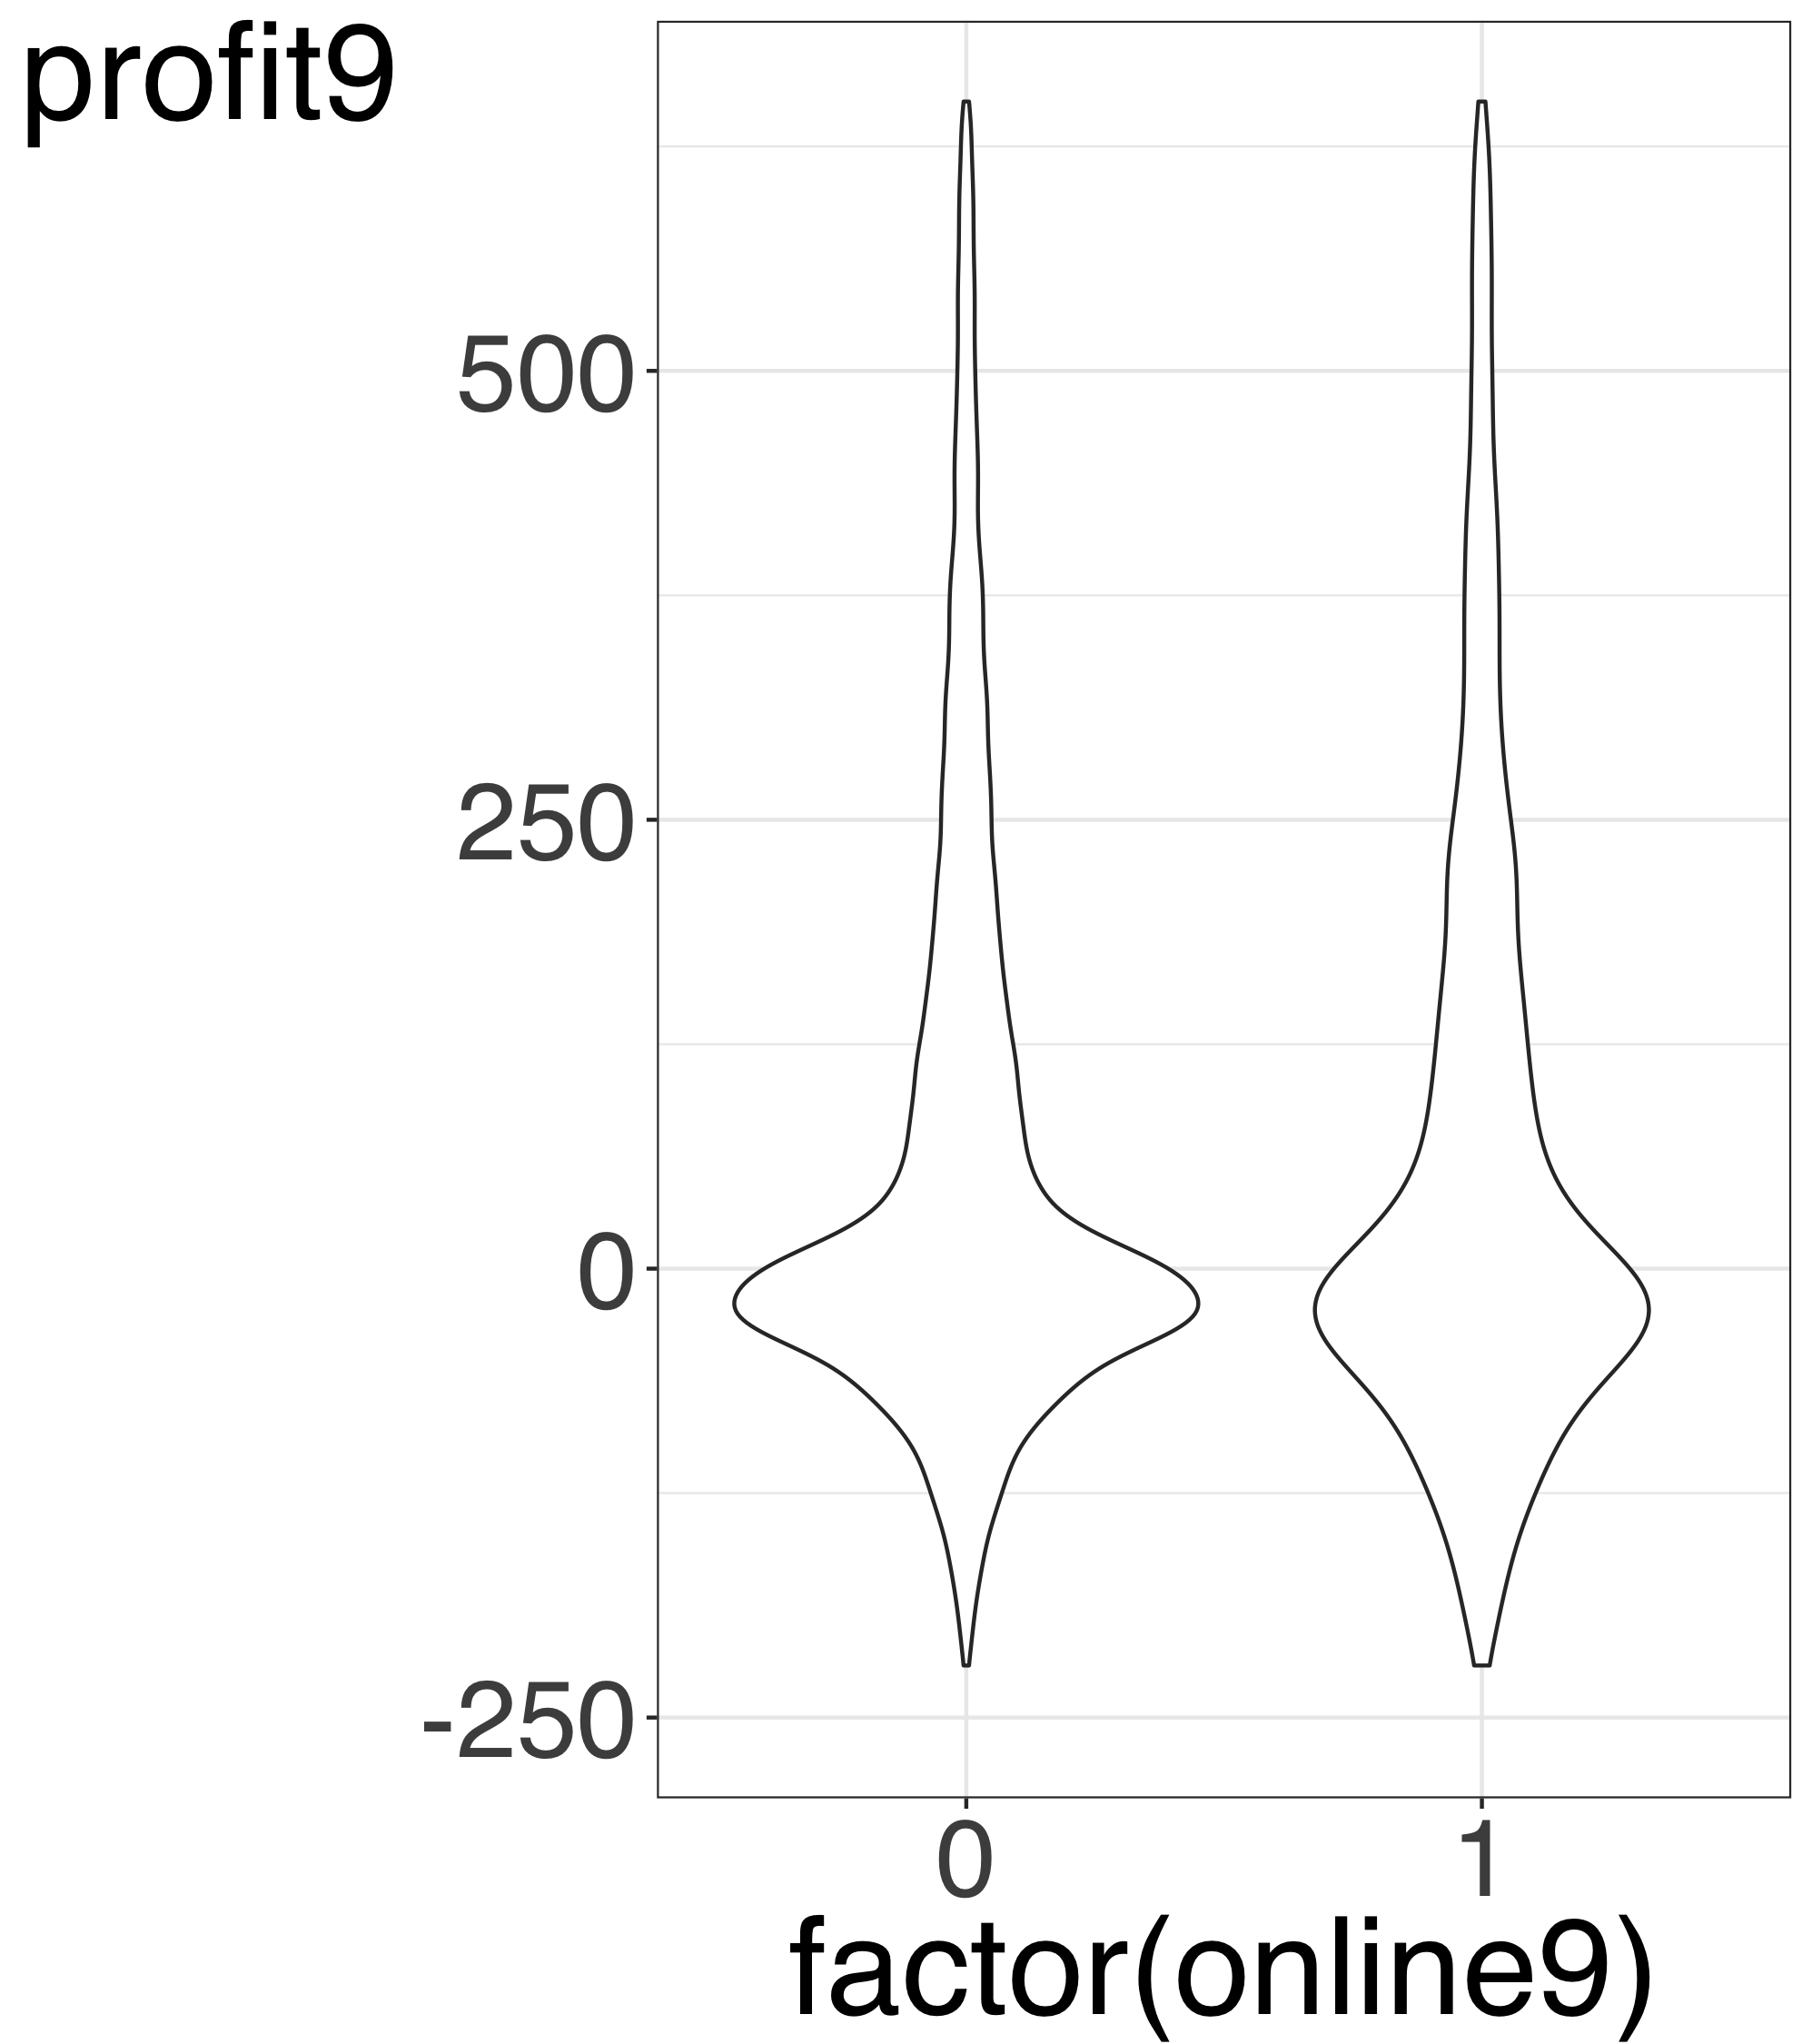

Slide 14
question 3
Is the difference in average profitability between online and offline customers in the sample indicative of a meaningful difference in profitability across these groups in the entire population of Pilgrim Bank’s customers?
At 95% confidence level, we could not find evidence that there is a difference between the groups for the whole population.

Slide 15
Question 3 Difference between Online & Offline
Hypothesis Test
Null Hypothesis: No Difference between groups
Alt Hypothesis: There is a difference between groups
P-value:
If you claim that Alt Hypothesis is true, what is the chance of being wrong

Slide 16

Question 3 Is There a Difference between Groups
 | Estimate | Std. Error | t value | Pr(>|t|)
(Intercept) | 110.79 | 1.64 | 67.68 | 0.00
factor(online9)1 | 5.88 | 4.69 | 1.25 | 0.21
We do not have enough evidence that the two groups are different

Slide 17
question 4
What is the role of customer demographics in comparing online and offline profitability?

Slide 18
Data Preparation: Handling missing data
Delete the record
If you have plenty of the data this can be best method
Replace with imputed value (such as mean median)
Reduces the correlations between variables
Replace with 0 and add a dummy variable
If missing 1 otherwise 0

Slide 19
Data Preparation: JOINING TWO Datasets
Use one of r join functions
inner_join
left_join
right_join
outer_join
anti_join

Slide 20
Question 4 Difference between Online & Offline Controlling for DEMOGRAPHIC VARIABLES
 | Estimate | Std. Error | t value | Pr(>|t|)
(Intercept) | 57.03 | 2.60 | 21.92 | 0.00
factor(online9)1 | 13.79 | 4.65 | 2.97 | 0.00
age | 17.68 | 0.67 | 26.40 | 0.00
We DO have evidence that the two groups are different!

Slide 21
Missing Variables In Analyzing the Relationships
Omitting important variables from the analysis can introduce bias to the coefficient estimate and p-value
We should strive to include all important variables
But, the challenge is: were to stop.

Slide 22
Question 4 Difference between Online & Offline Controlling for DEMOGRAPHIC VARIABLES
 | Estimate | Std. Error | t value | Pr(>|t|)
(Intercept) | -87.25 | 6.46 | -13.50 | 0.00
factor(online9)1 | 11.87 | 4.65 | 2.55 | 0.01
age | 26.89 | 1.08 | 24.94 | 0.00
income | 18.77 | 0.75 | 25.09 | 0.00
factor(missing_age)TRUE | 94.31 | 9.18 | 10.28 | 0.00
factor(missing_income)TRUE | 63.55 | 9.05 | 7.02 | 0.00
We DO have evidence that the two groups are different

Slide 23
question 5
To what extent the profit in 1999 can help us predict profit in 2000?

Slide 24
